Slide 1
Cansolair Efficiency Monitoring System
Progress Update by: Dylan Stone

Slide 2
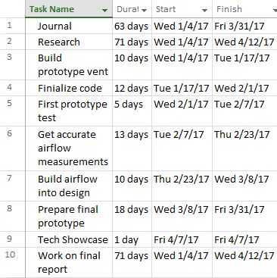
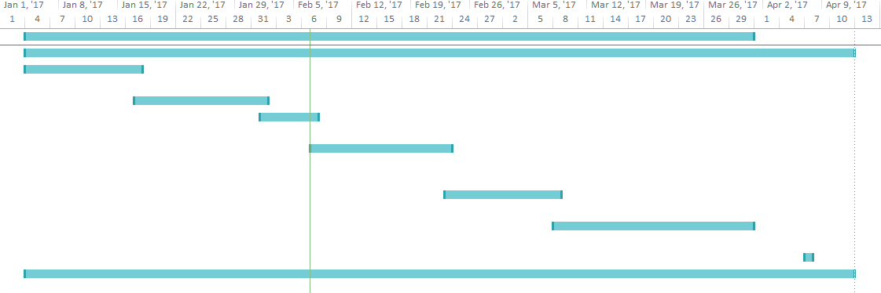
Gantt Chart and Timeline

Slide 3
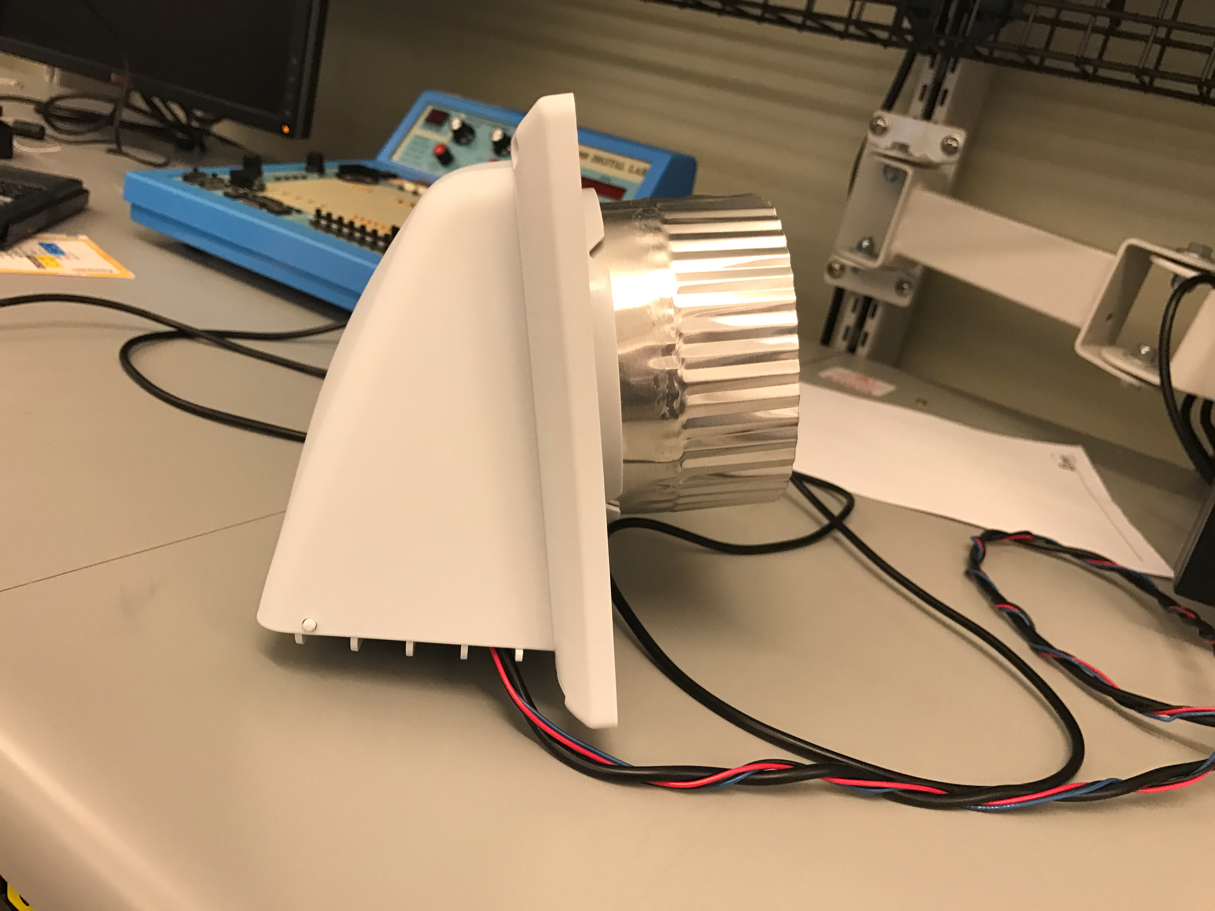
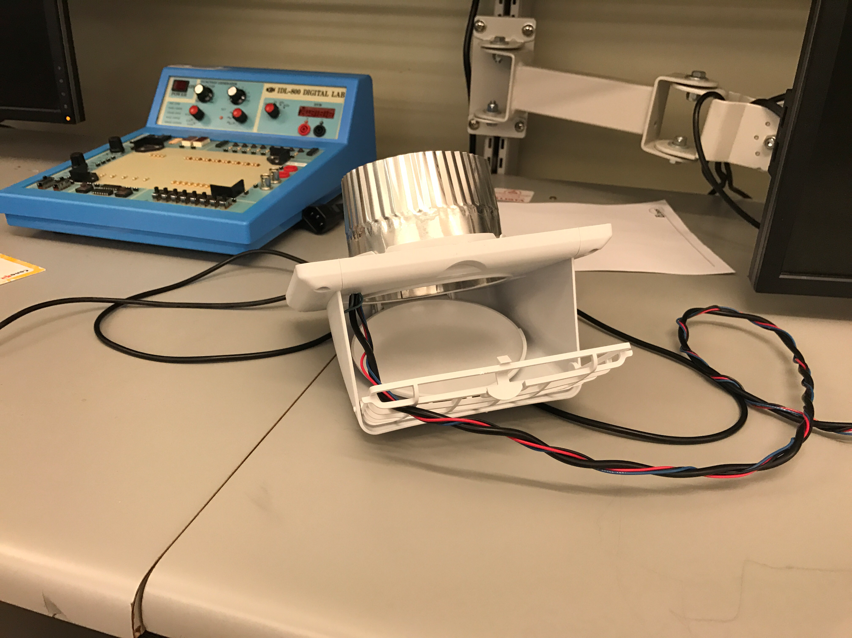
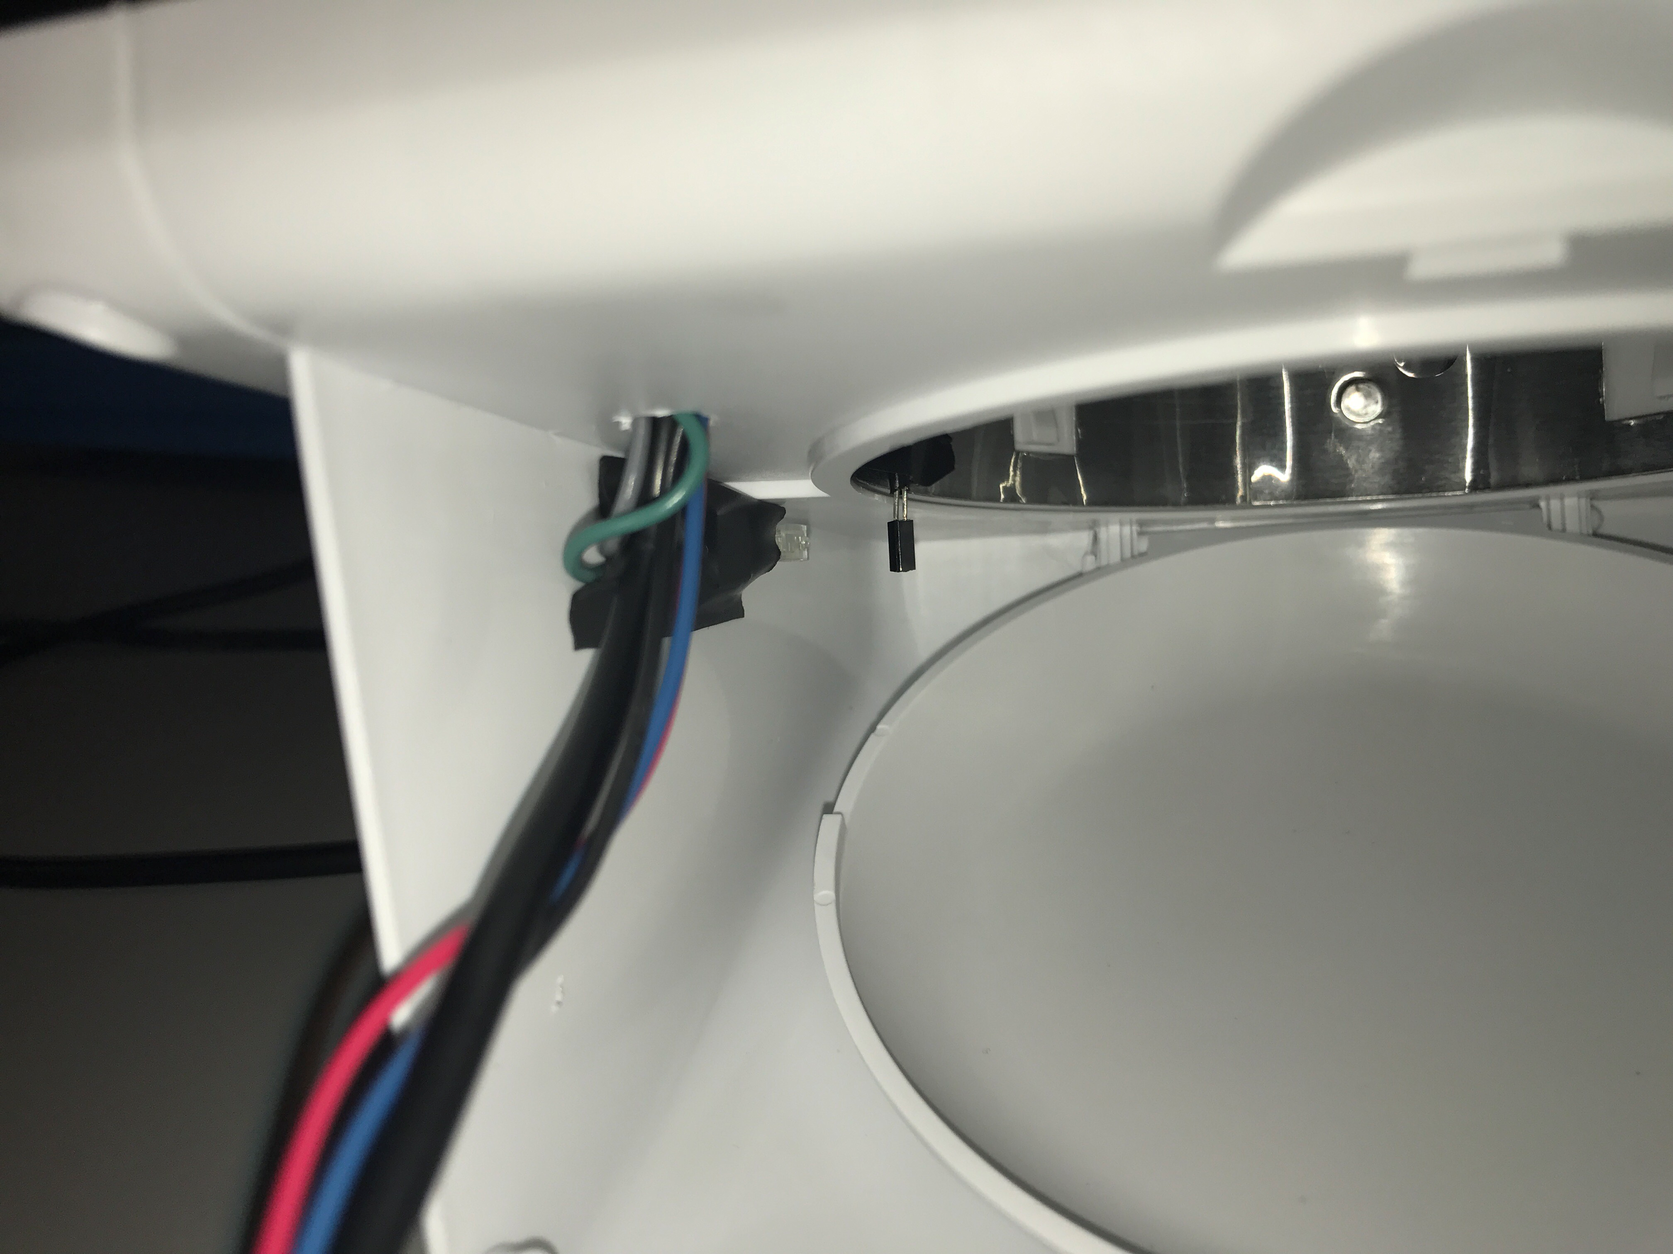
First Prototype

Slide 4
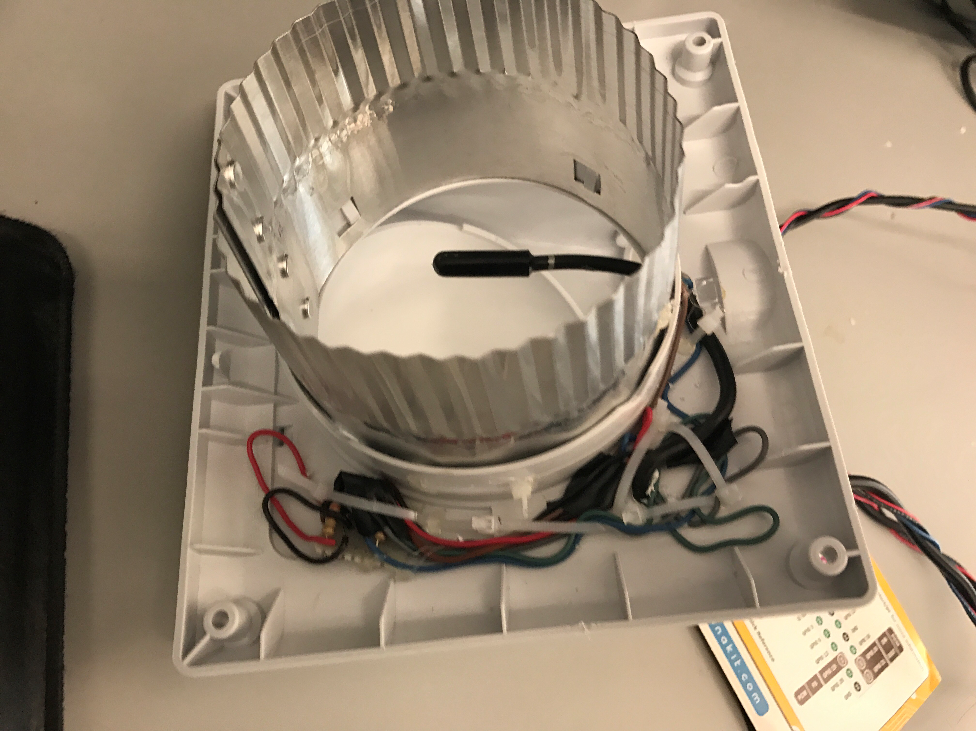
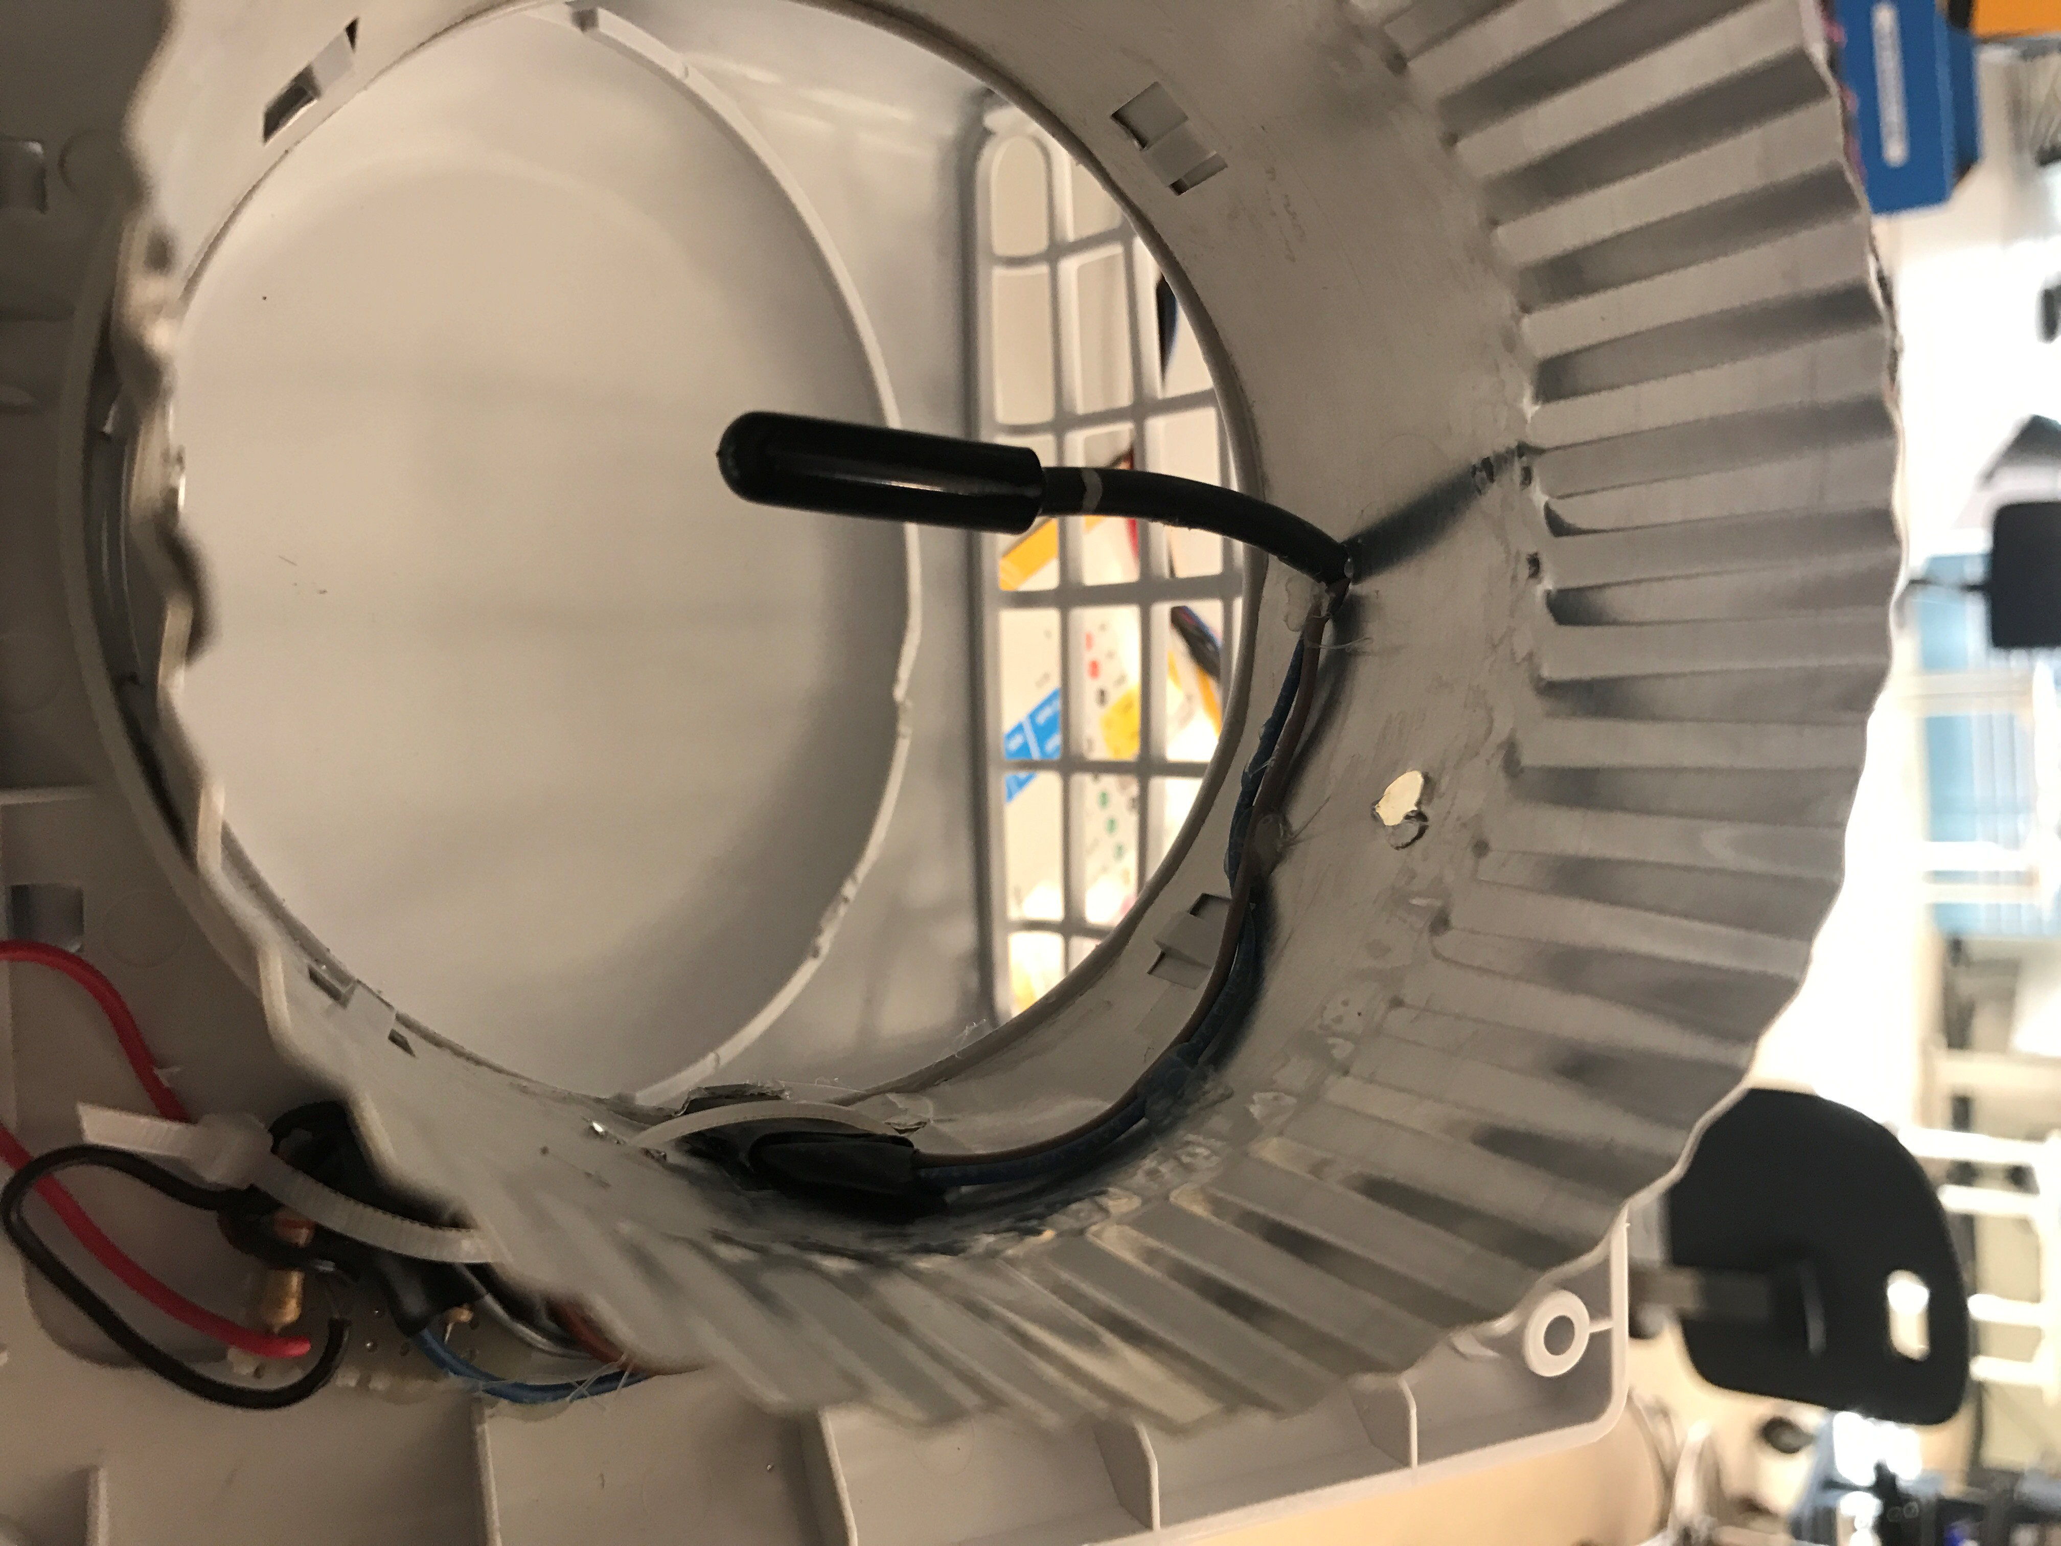
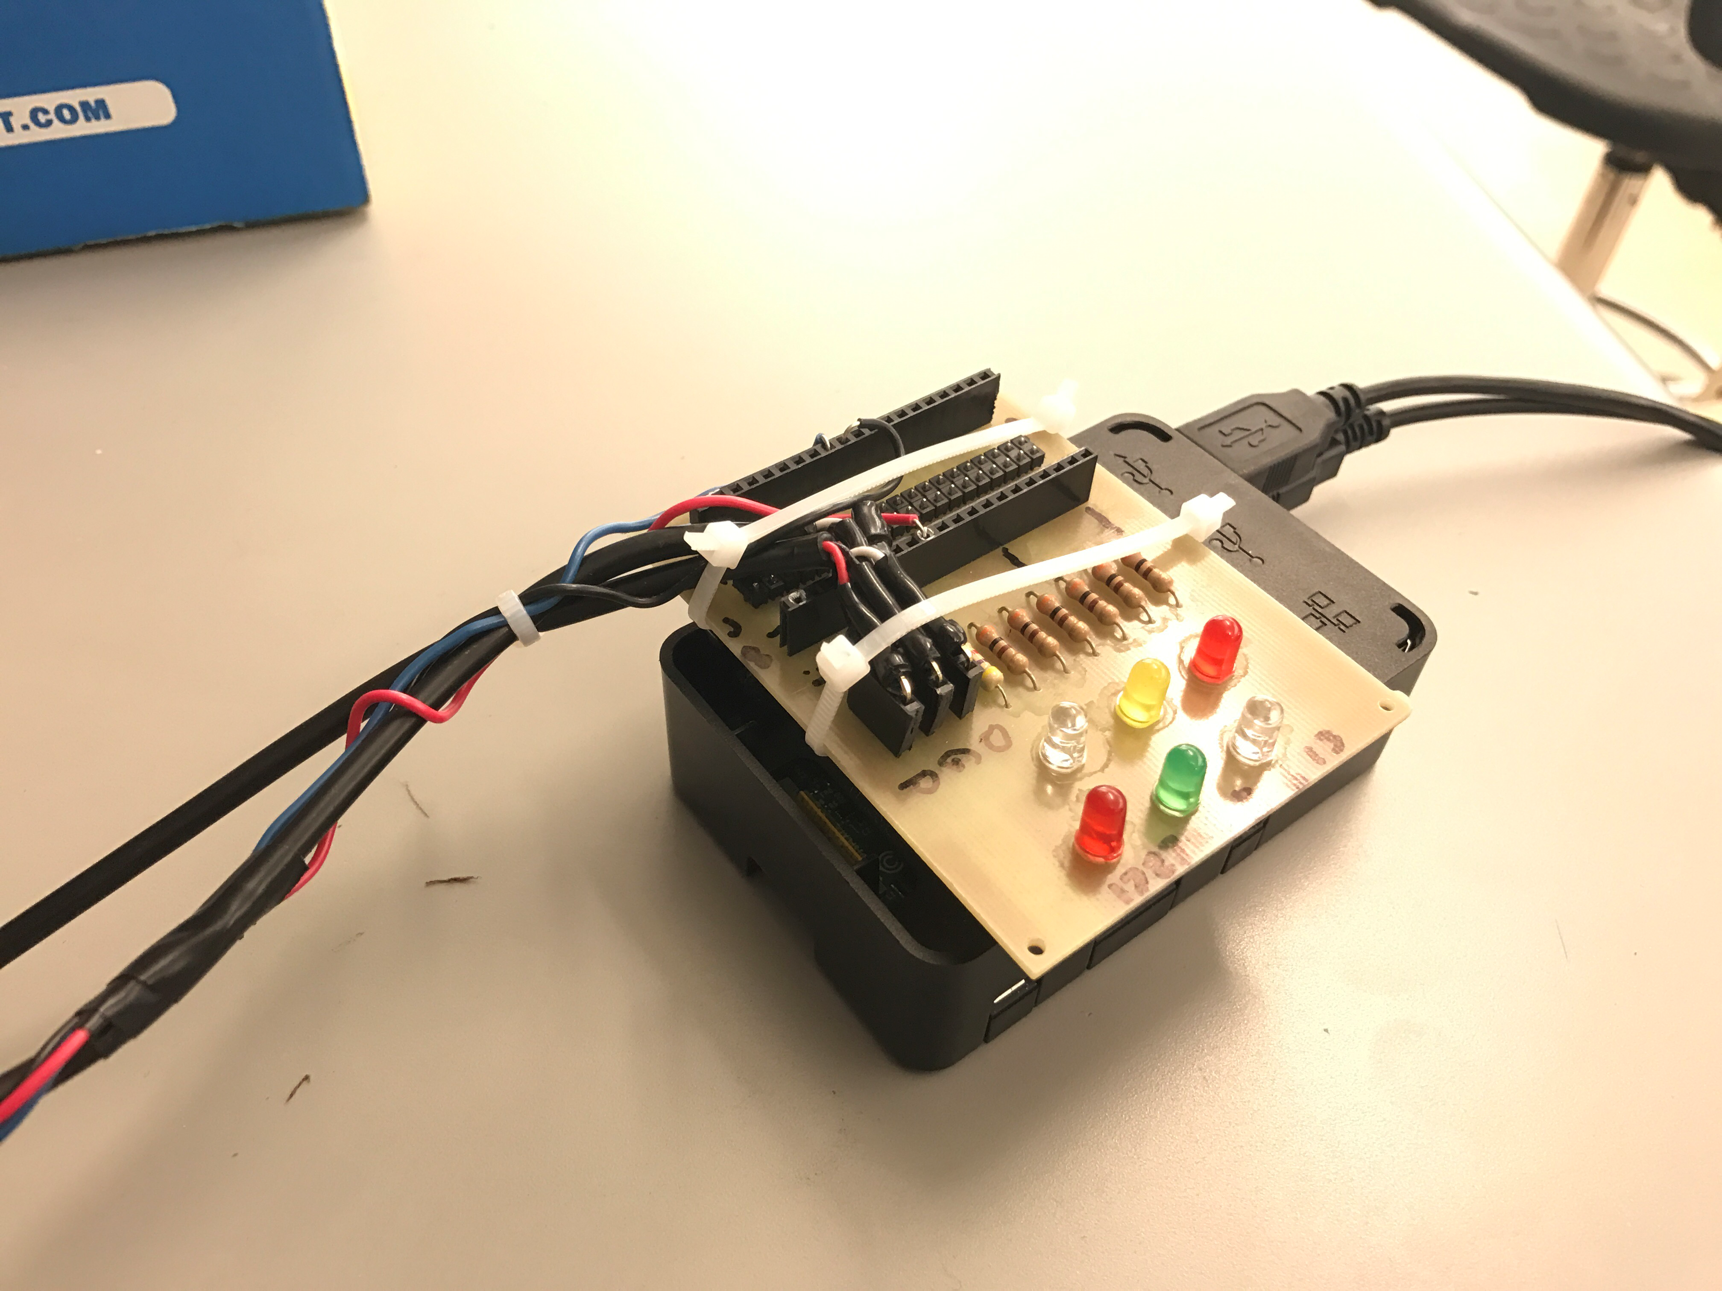
First Prototype

Slide 5
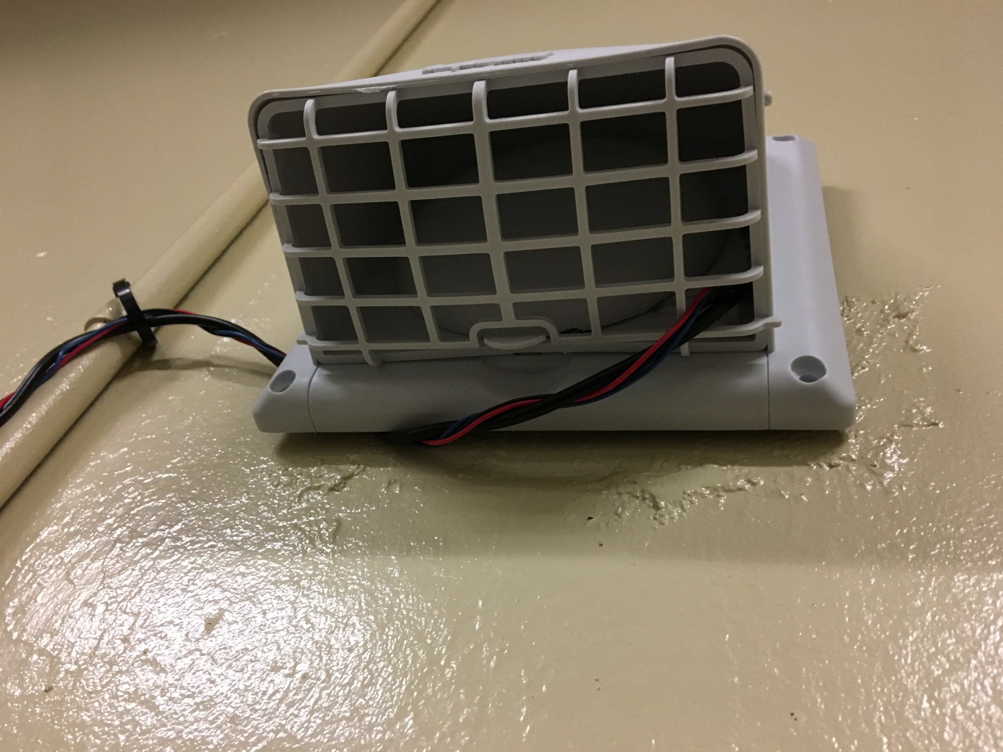
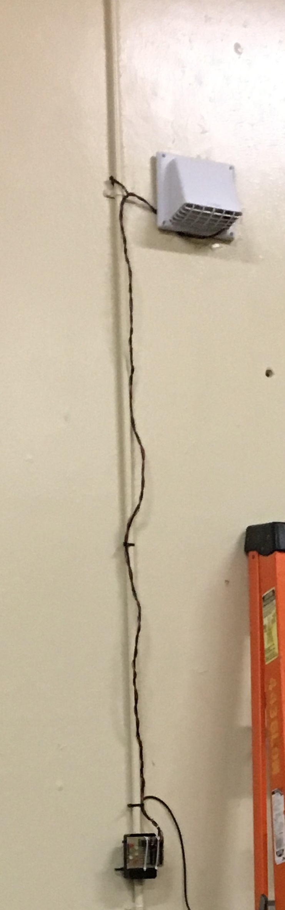
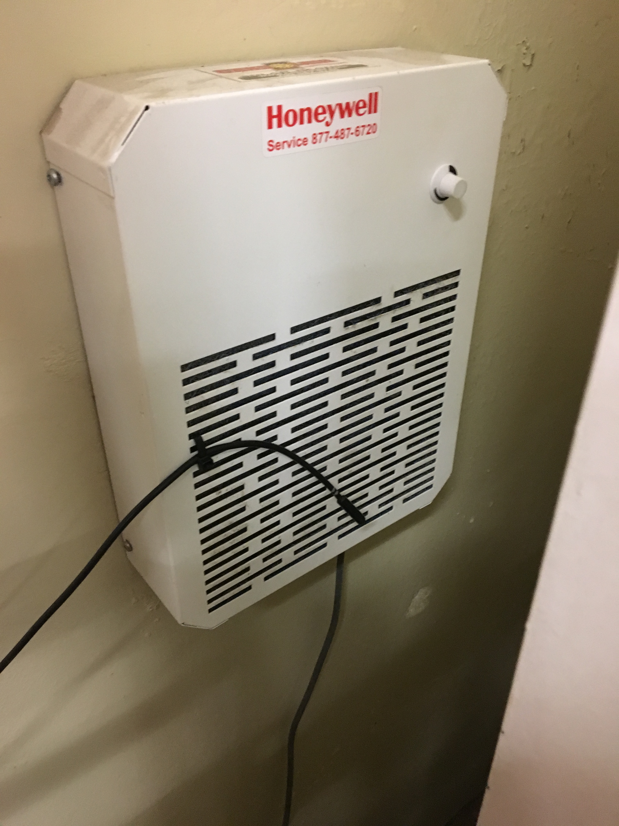
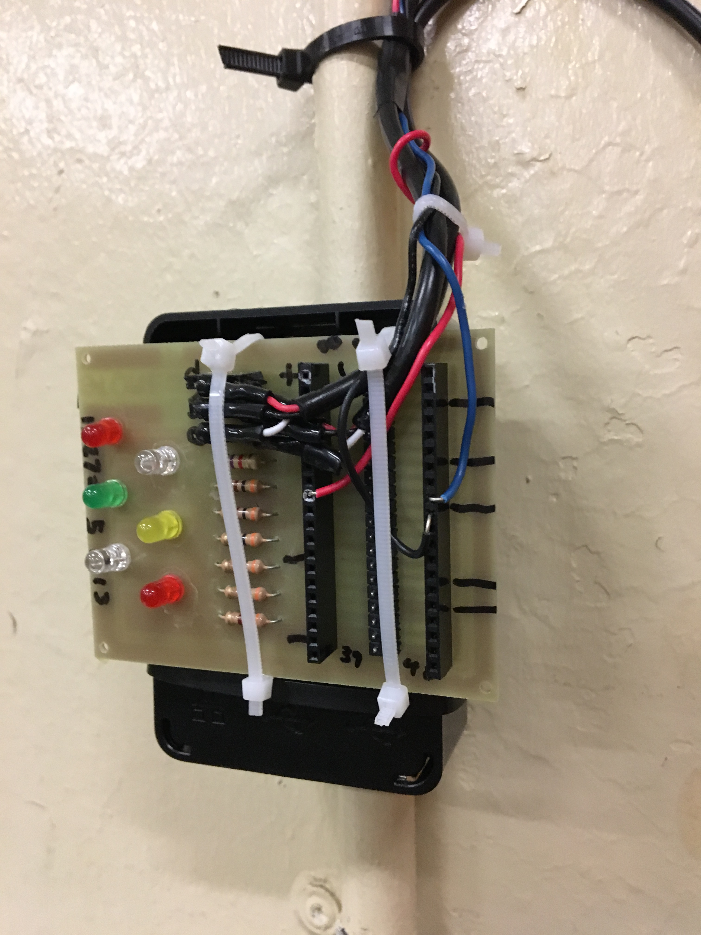

Installation

Slide 6
Data for Thursday
Thu Feb 2 14:32:58 2017 | 24.437 | 1.187 | 23.25 | TRUE | 1229.344 | 0.048 | 0
Thu Feb 2 14:33:01 2017 | 24.312 | 1.187 | 23.125 | TRUE | 1222.734 | 0.049 | 0
Thu Feb 2 14:33:04 2017 | 24.312 | 1.187 | 23.125 | TRUE | 1222.734 | 0.049 | 0
Thu Feb 2 14:33:07 2017 | 24.312 | 1.187 | 23.125 | TRUE | 1222.734 | 0.049 | 0
Thu Feb 2 14:33:09 2017 | 24.312 | 1.187 | 23.125 | TRUE | 1222.734 | 0.049 | 0
Thu Feb 2 14:33:13 2017 | 24.312 | 1.187 | 23.125 | TRUE | 1222.734 | 0.05 | 0
Thu Feb 2 14:33:16 2017 | 24.375 | 1.187 | 23.188 | TRUE | 1226.065 | 0.05 | 0
Thu Feb 2 14:33:26 2017 | 24.5 | 1.187 | 23.313 | FALSE | 0 | 0 | 0.05
Thu Feb 2 14:33:36 2017 | 24.625 | 1.187 | 23.438 | FALSE | 0 | 0 | 0
Thu Feb 2 14:33:46 2017 | 24.687 | 1.187 | 23.5 | FALSE | 0 | 0 | 0
Total kWh per day
1 | 0
2 | 1.954
3 | 1.705
4 | 1.046
5 | 0.154
6 | 0.66
7 | 0.723

Slide 7
Data

Slide 8
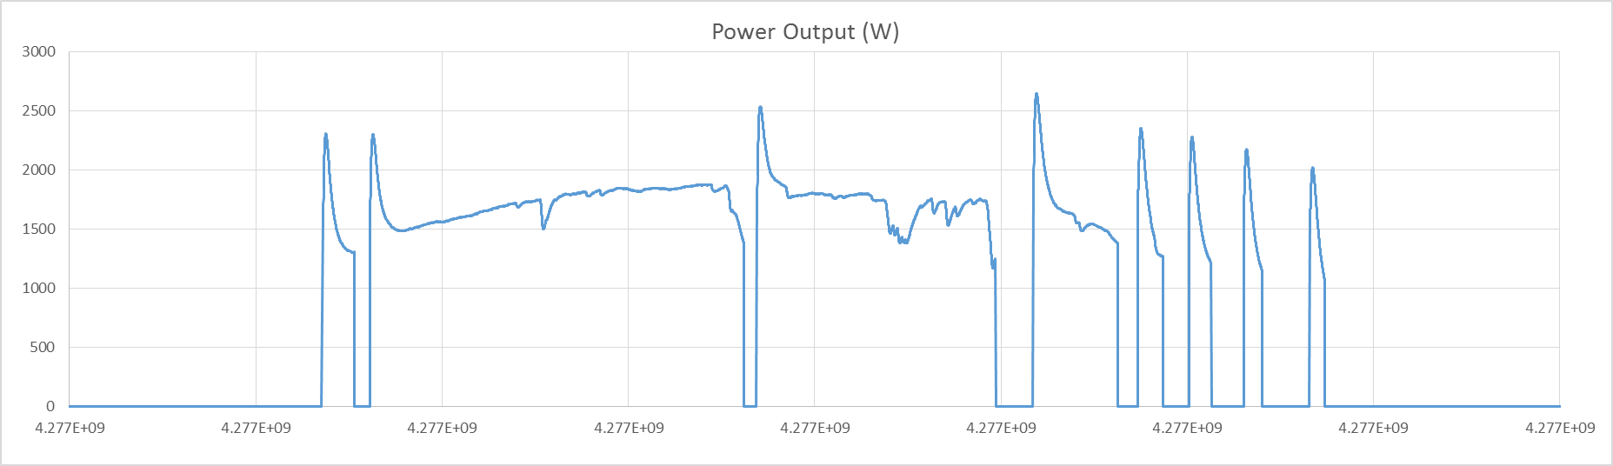
Data

